Slide 1
A MAJOR PROJECT (Review-3) ON CAR PRICE PREDICTION USING MACHINE LEARNING BACHELOR OF TECHNOLOGY IN COMPUTER SCIENCE AND ENGINEERING By B.SHARATH CHANDRA REDDY (19E41A05K4) CH. KARTHIK (19E41A05G2) Y.AKSHITH (19E41A05H9) AC.ADARSH (19E41A05M0)
Under the Guidance of DEEPTHI KANDE ACADEMIC BATCH: 2019-2023

Slide 2
CONTENTS
ABSTRACT
PROBLEM STATEMENT
LITERATURE SURVEY
EXISTING SYSTEM & DRAWBACK OF EXISTING SYSTEM
PROPOSED SYSTEM & ADVANTAGES OF PROPOSED
SOFTWARE & HARDWARE REQUIREMENTS
IMPLEMENTATION
SYSTEM ARCHITECTURE
CODING
TESTING (TEST PLAN / TEST CASES)
FUTURE SCOPE
CONCLUSION
REFERENCES

Slide 3
ABSTRACT
A car price prediction to build a model to predict used cars reasonable prices based on multiple aspects, including vehicle mileage, year of manufacturing, fuel type, transmission type, fuel type, and engine Cc.
This model can benefit sellers, buyers, and car manufacturers in the used cars market.
The model building process involves machine learning Concept.
The dataset was used from listings of used cars.
COLLECTING THE DATA:
We have Collected the data for over 5000 cars using Selenium script from 4 different websites from different locations around the country. The websites are as followed:
Olx.com.
Cars24.com.
CarDekho.com.

Slide 4
PROBLEM STATEMENT
The used car market is a huge and important market for car manufacturers.
The second-hand car market is also very likely linked to new car sales.
Therefore, require good decision support systems to maintain the profit of the used car business.
Selling used cars at new car retail and handling lease returns and fleet returns from car rental companies require car manufacturers to be involved in the used car market.
This project is all about predicting the used car's prices. In our day to life, everyone wants a car, but budget is the problem, so in this project build a model that will take certain parameters as arguments and result or predict the price of the car based on given parameters.
THIS CAR PRICE PREDICTION IS BASED ON THIS ALGORITHM
LINEAR REGISSION ALGORITHM.

Slide 5
LITERATURE SURVEY
"Used Car Price Prediction Using Machine Learning Techniques" by Anusree M. Nair, Vidya Raj, and S. Sreejith.
This study compares the performance of different machine learning algorithms, including linear regression, decision tree regression, and random forest regression, for predicting used car prices. The authors used features such as car age, mileage, fuel type, and engine size to build their models.
"Car Price Prediction using Machine Learning Techniques" by Abdulhamid H. Ali and Mustafa M. Abayomi.
This research focuses on predicting car prices using regression models and compares the performance of linear regression, support vector regression, and artificial neural networks. The study considers features such as car age, mileage, brand, and model as inputs to the models.
"Car Price Prediction using Machine Learning Algorithms" by Abhishek Raghunath and Dr. S. Ajitha.
This study explores the effectiveness of various machine learning algorithms, including decision tree, random forest, and gradient boosting, for car price prediction. The authors use features such as car age, mileage, engine power, and brand to build their models.

Slide 6
EXISTING SYSTEM
In the existing system, to predict the price of vehicles for four wheeler, a lot of data mining algorithms and machine learning algorithms were widely used.
The major drawback of this existing system is they need more attributes in order to predict the vehicle price.
More comparison techniques must be used to get the result more efficiently.
It is highly complicated to get sufficient data sets that were spread widely all over the world.
The datasets can be collected only through online.
But not on the offline mode. It is not possible for everyone to collect the data sets through online mode particularly in rural areas.

Slide 7
DRAWBACK OF EXISTING SYSTEM
Limited data availability.
Data quality issues.
Lack of real-time updates.
Loss the user money.
Dependency on historical data.
Performance and scalability.

Slide 8
PROPOSED SYSTEM
To overcome this problem we have developed a model which will be highly effective.
Machine learning Algorithms are used because they provide us with continuous value as an output and not a categorized value.
Because of which it will be possible to predict the actual price a car rather than the price range of a car.
User Interface has also been developed which acquires input from any user and displays the Price of a car according to user’s inputs.

Slide 9
ADVANTAGES OF PROPOSED SYSTEM
Highly effective.
Automated price prediction.
Improved Accuracy.
Real-time prediction.
User-friendly interface.
There is no third party.

Slide 10
SOFTWARE & HARDWARE REQUIREMENTS
SOFTWARE REQUIREMENTS:
Operating system : Windows 7 or Above.
Coding Language : Python.
Front-End : Python.
Back-End : Django.
Designing : Html, css, javascript.
Data Base : MySQL.
HARDWARE REQUIREMENTS:
Processor - i3 or Above.
RAM - 4 GB or Above.
Hard Disk - 50 GB or Above.
Key Board - Standard Window Keyboard.
Mouse - Optical Mouse.
Monitor - Monitor or Laptop.

Slide 11
IMPLEMENTATION
USER MODULE :
Car Price Prediction
Register page.
Sign up page.
Select company.
Select Model.
Select year of Manufacture.
Select Fuel Type.
Enter The Kilometers travelled.
Predict Price.

Slide 12
DESIGN: SYSTEM ARCHITECTURE:
DATA SET
FEATURE EXTRACTION
TRAINING DATASET
TEST DATASET
RESULT FOR PRICE PREDICTION

Slide 13
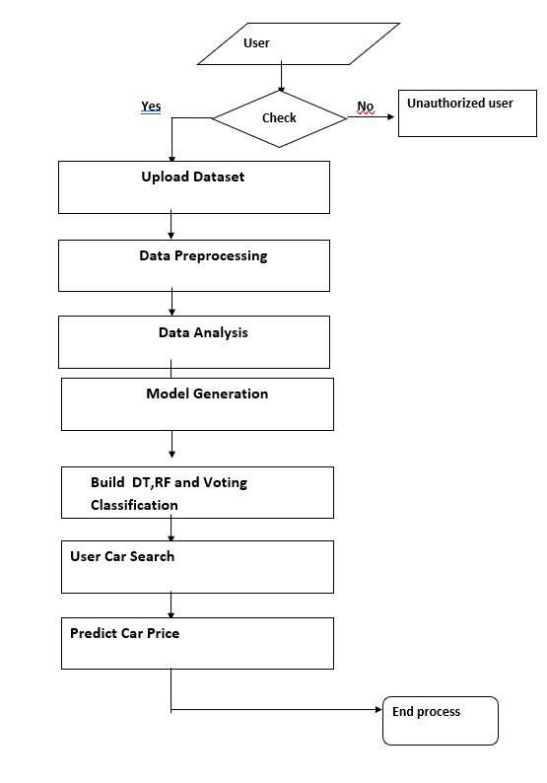
DATA FLOW DIAGRAM:

Slide 14
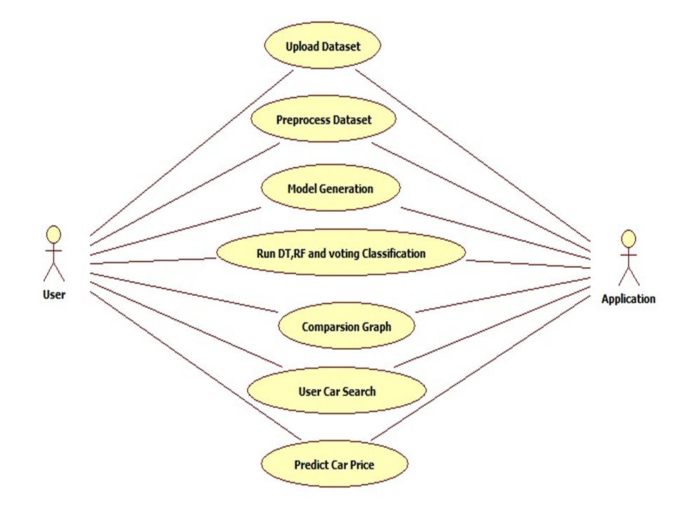
USE CASE DIAGRAM:

Slide 15
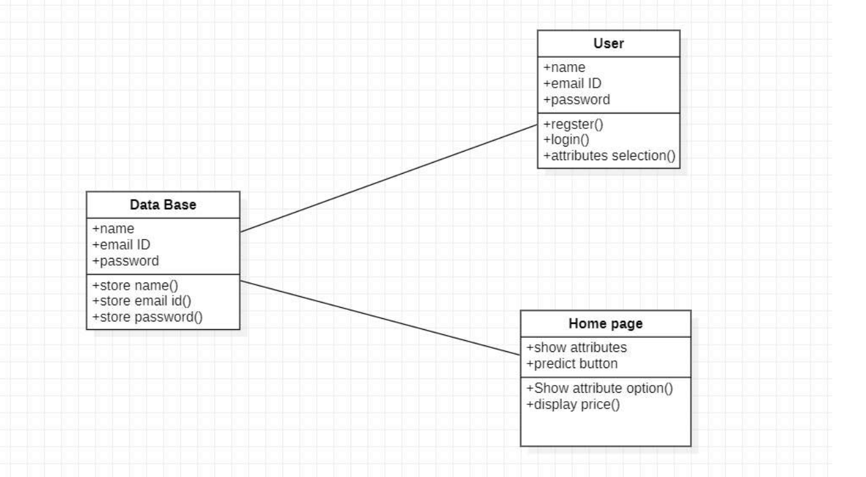
CLASS DIAGRAM:

Slide 16
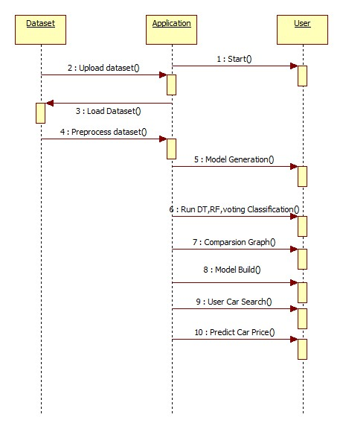
SEQUENCE DIAGRAM:

Slide 17
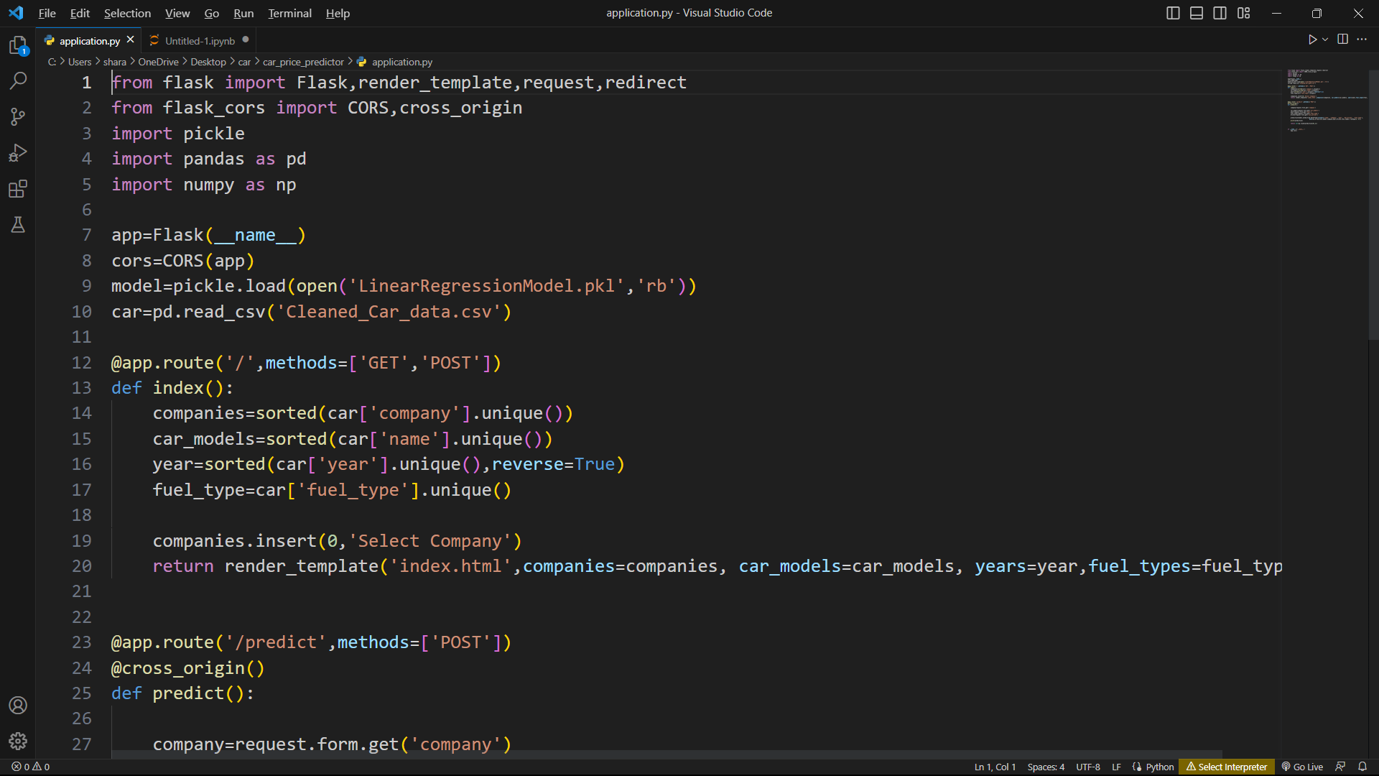
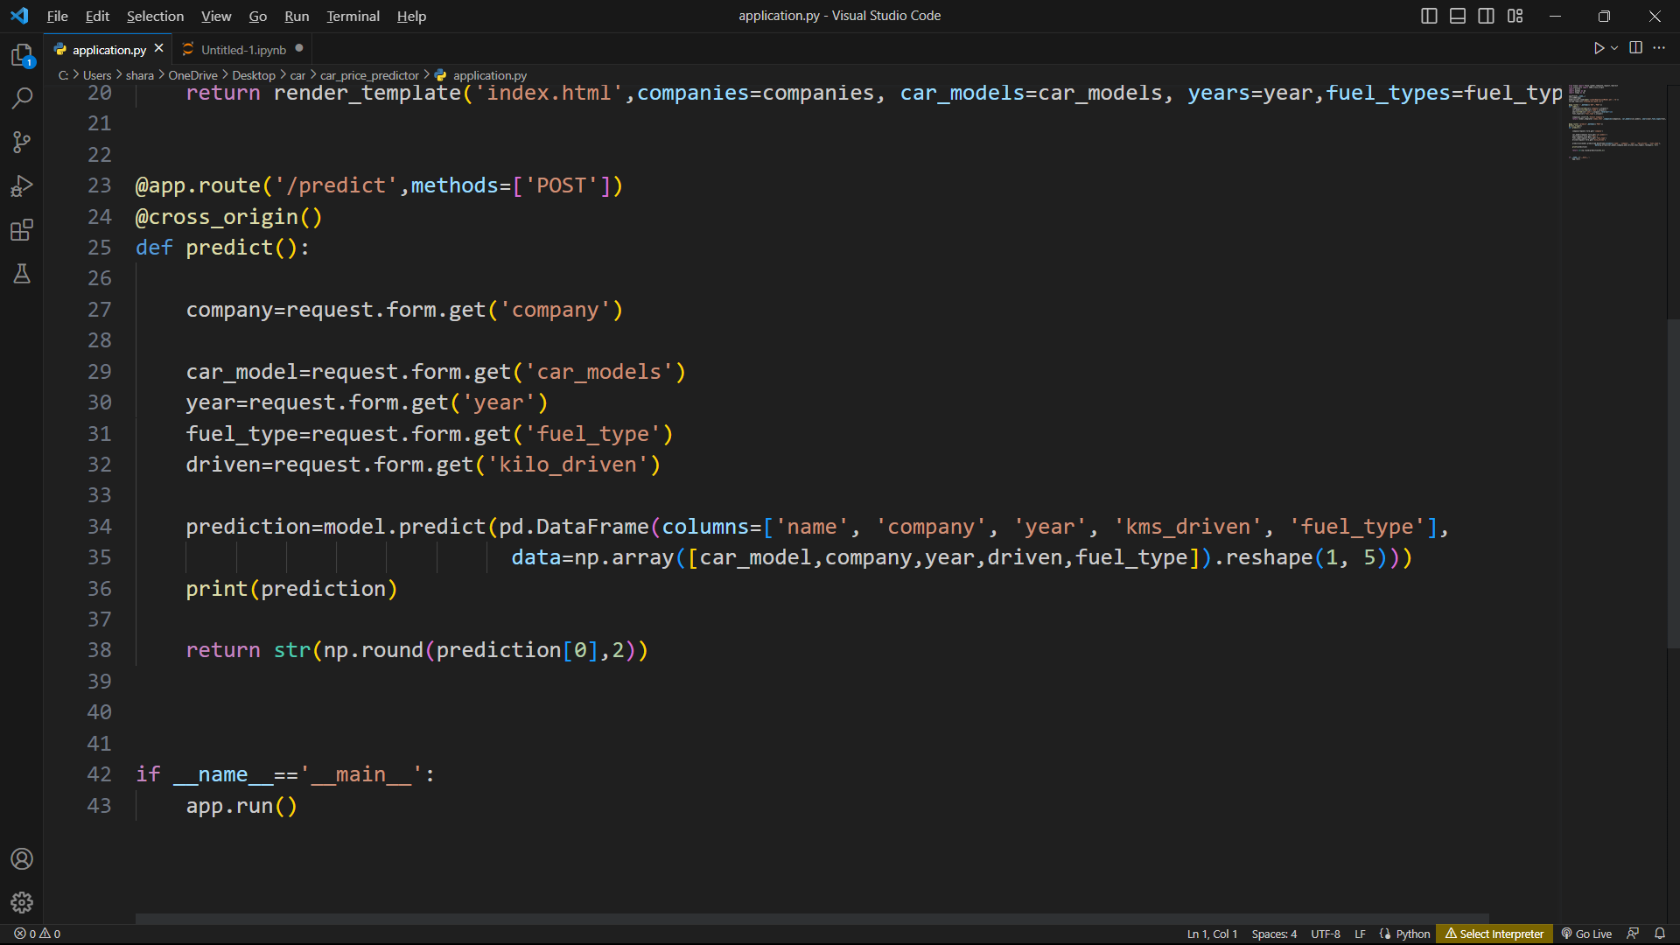
CODING: SOURCE CODE:

Slide 18
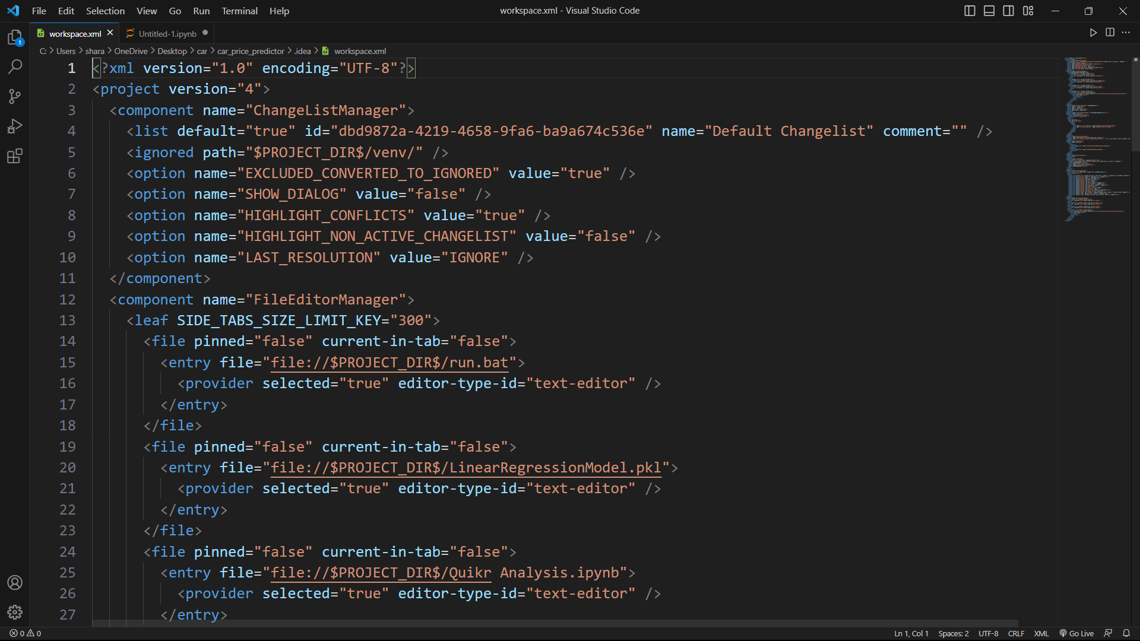
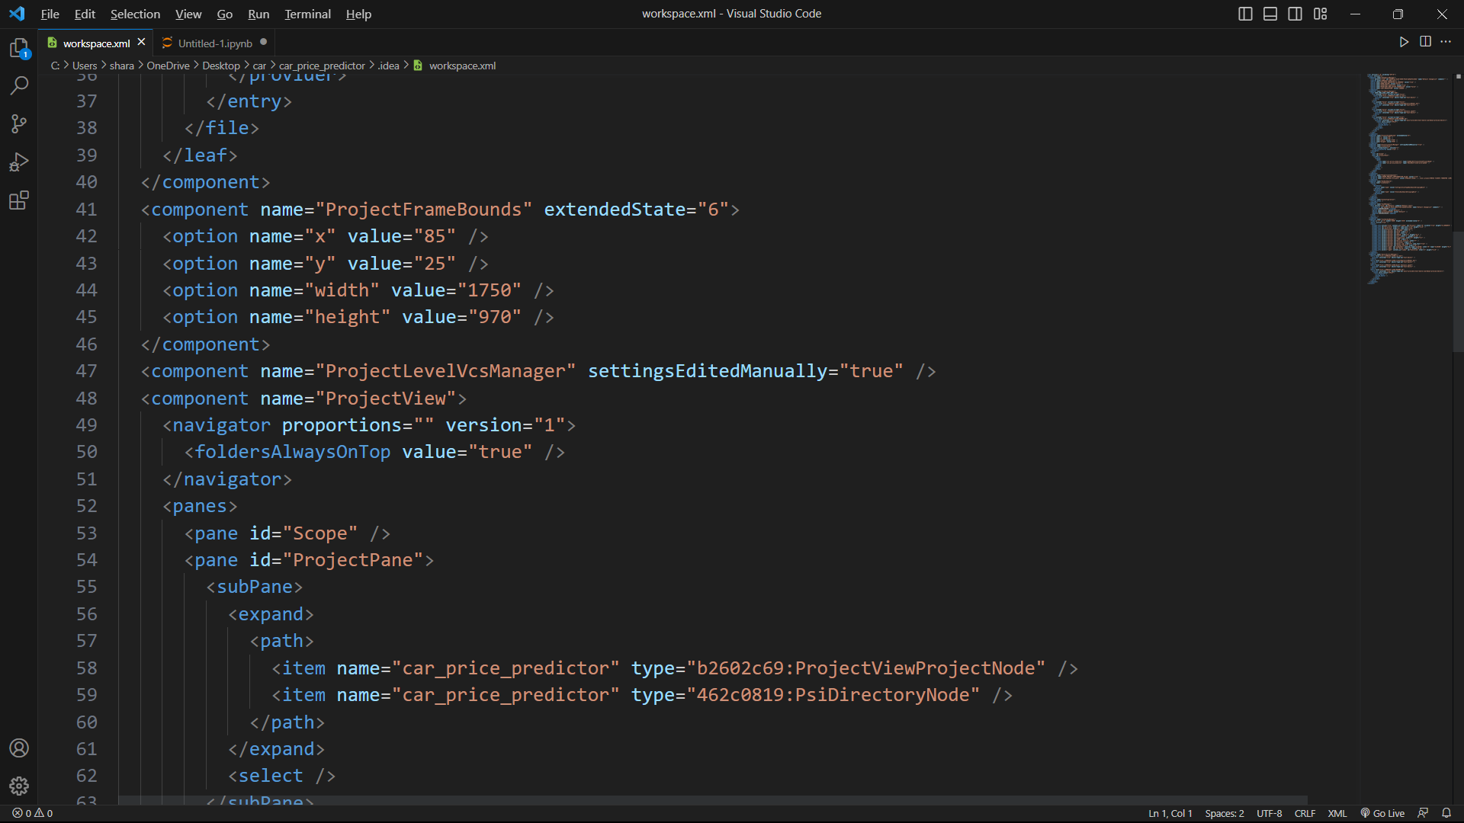

Slide 19
TESTING:
TEST PLAN:
Launching Home Page
Registration of user details
login Positive Test Case
Displaying attributes
Selecting attributes
Price Prediction Test case with selecting correct attributes
Price Prediction Test case without selecting one or more attributes.
Home button Test case
Logout button Test case

Slide 20
TEST CASES:
Use case ID | CAR PRICE PREDICTION USING MACHINE LEARNING
Use case Name | Home button
Description | Display home page of application
Primary actor | User
Precondition | User must open application
Post condition | Display the Home Page of an application
Frequency of Use case | Many times
Alternative use case | N/A
Use case Diagrams | Diagram in below slide
Attachments | N/A

Slide 21
FUTURE SCOPE
In future we extend to add certain extra features like Bike, Heavy vehicle transport also.
The main limitation of this study is the low number of records that have been used.
As future work, we intend to collect more data and to use more advanced techniques like artificial neural networks, fuzzy logic and genetic algorithms to predict car prices.

Slide 22
CONCLUSION
Car price prediction can be a challenging task due to the high number of attributes that should be considered for the accurate prediction.
The major step in the prediction process is collection and preprocessing of the data.
In this paper, we check out the software of supervised device learning strategies to are expecting the charge of used automobiles.
Different strategies (Regression Algorithms) are used to make the predictions.
The predictions are then evaluated and in comparison on the way to discover the ones which offer the best performances.

Slide 23
REFERENCES
E. Gegic, B. Isakovic, D. Keco, Z. Masetic, and J. Kevric,-Car price prediction using machine learning techniques,‖ 2019.
N. Pal, P. Arora, P. Kohli, D. Sundararaman, and S. S. Palakurthy, ―How much is my car worth? a methodology for predicting used cars prices using random forest,‖ in Future of Information and Communication Conference. Springer, 2018, pp. 413–422.
LISTIANI, M., 2009. Support Vector Regression Analysis for Price Prediction in a Car Leasing Application. Thesis (MSc). Hamburg University of Technology.
RICHARDSON, M., 2009. Determinants of Used Car Resale Value. Thesis (BSc). The Colorado College.
WU, J. D., HSU, C. C. AND CHEN, H. C., 2009. An expert system of price forecasting for used cars using adaptive neuro-fuzzy inference. Expert Systems with Applications. Vol. 36, Issue 4, pp. 7809-7817.
K. Noor and S. Jan, ―Vehicle price prediction system using machine learning techniques,‖ International Journal of Computer Applications, vol. 167, no. 9, pp. 27–31, 2017.

Slide 24


